Slide 1
DTS207TC Database Development and Design
Lecture 8
More UML
Chap 12. Physical Storage System*
Di Zhang, Autumn 2025
Titles with * will not be assessed
Notes:
I am very happy to have the opportunity to meet with you all in this course.

Slide 2
Outline
UML Class Diagram (supplement based on Lec6)
Structure of a computer*
Storage System*
RAID*

Slide 3
Review of UML class diagram
Class diagram
Structure
Relationship
Association
Dependency
Aggregation
Composition

Slide 4

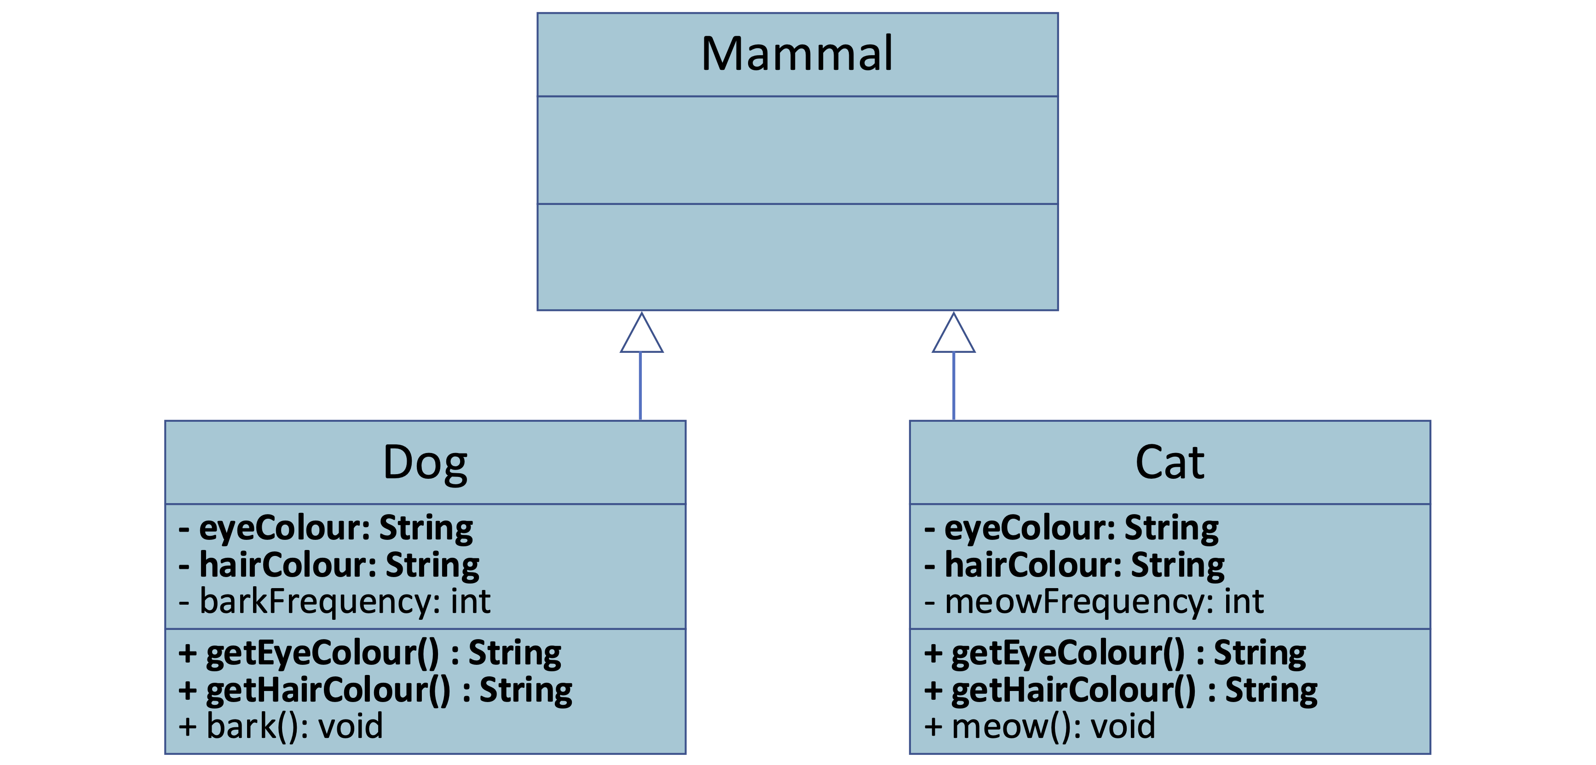
Inheritance / Generalization
Content:
Definition: Represents an "is-a" relationship between classes.
Notation: Hollow triangle + solid line.
Example: Animal △ | Dog , Animal △ | Cat.
Semantics
A subclass inherits attributes and operations from its superclass and can extend or override them.
Notes
This is a core concept of OOP, used to achieve polymorphism and code reuse.
1

Slide 5
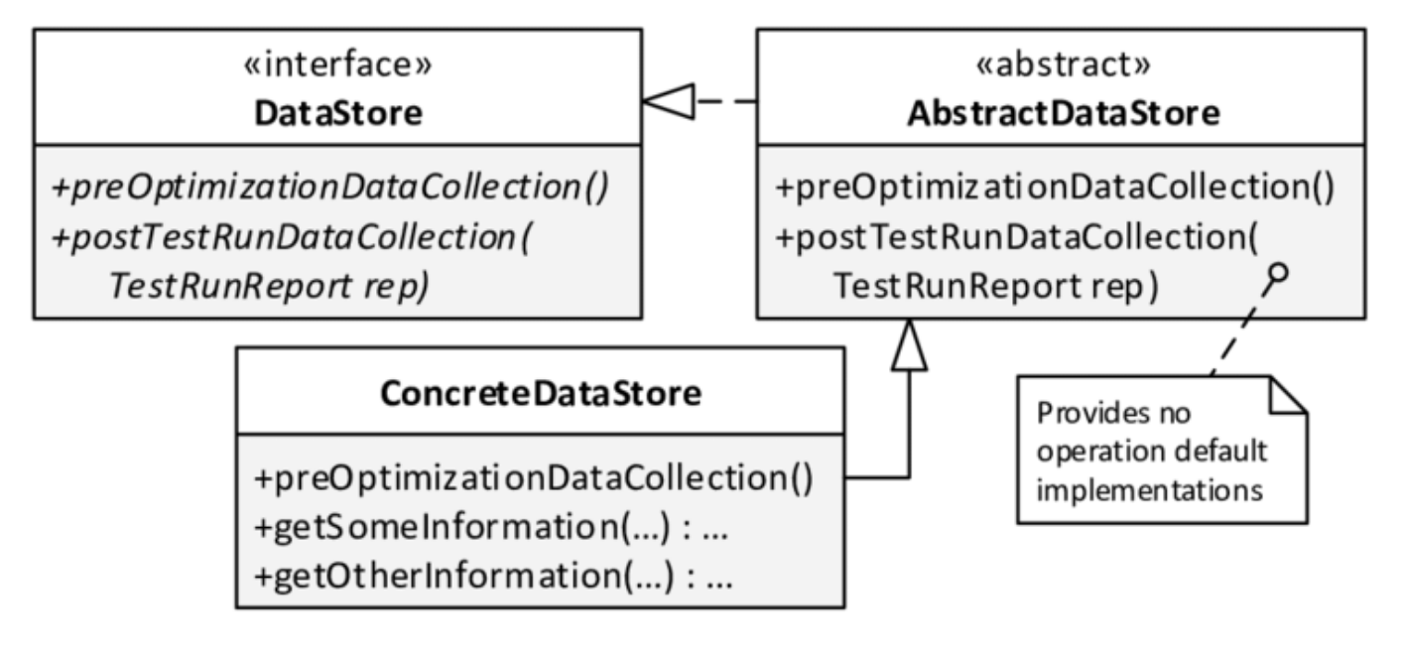
Interfaces/Abstract class
Definition:
An abstract class is a class that cannot be instantiated and may contain both abstract methods (without implementation) and concrete methods (with implementation).
An interface defines a contract that implementing classes must follow. It contains only method signatures (no implementation) and sometimes constants.
A class implements an interface or abstract class, promising to provide all operations defined in the interface.
Notation: Hollow triangle + dashed line.
Example:
2

Slide 6
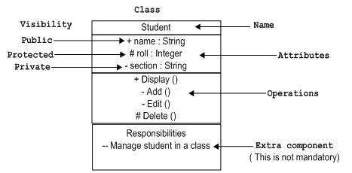
Visibility: The Key to Encapsulation
+ Public: Visible to all classes.
- Private: Visible only to the owning class.
# Protected: Visible to the owning class and its subclasses.
2

Slide 7
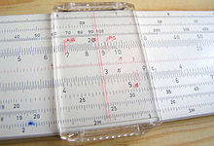
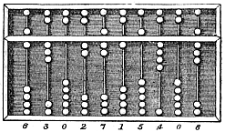

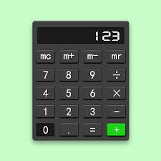
What is a Computer?
Suanpan
Slidable Ruler
Paper Computer
Three-Body
Minecraft
Calculator
Notes:
https://en.wikipedia.org/wiki/Computer

Slide 8

Computer
A computer is a machine that can be programmed to automatically carry out sequences of arithmetic or logical operations.
https://en.wikipedia.org/wiki/Computer

Slide 9
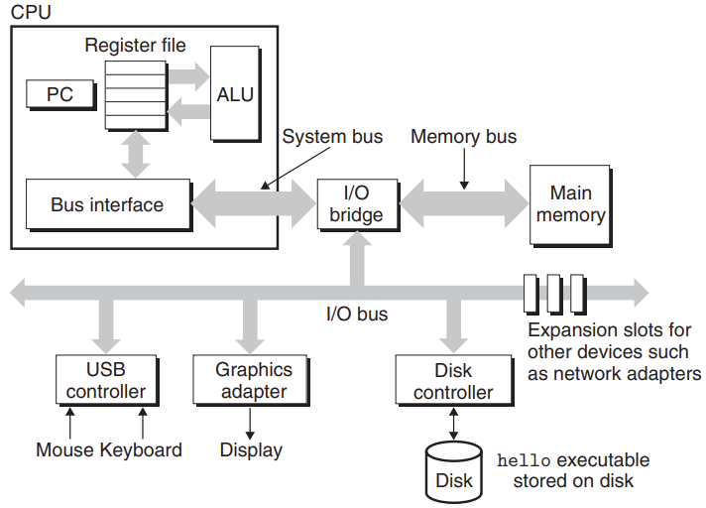
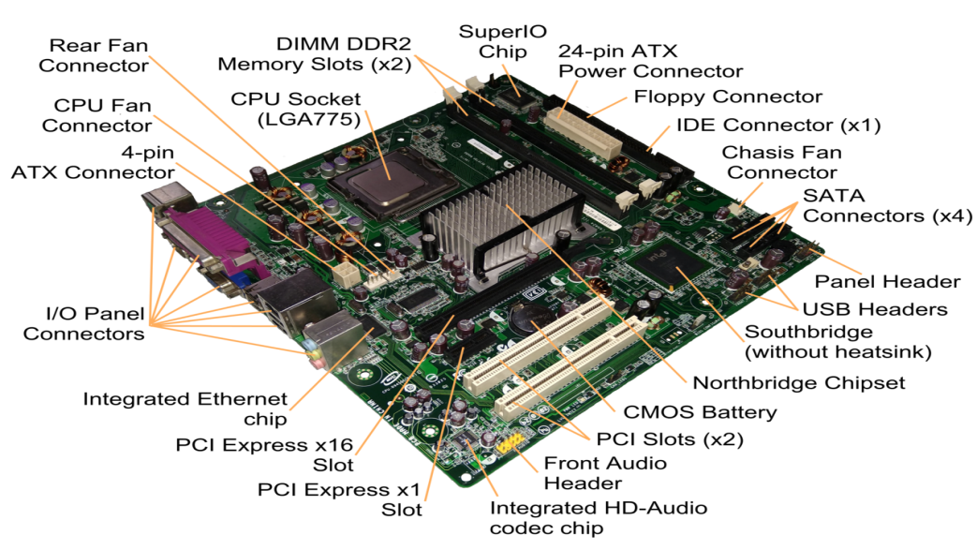
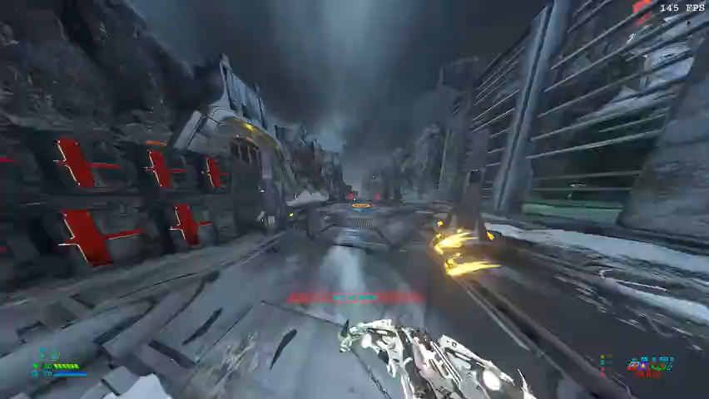
Structure of a personal computer
von neumann architecture
The main components (review of 103) :
CPU
I/O
Memory
Graphic card
Intel D945GCCR
Doom: PC Graphics Benchmark
Notes:
If you disassemble a computer case, you can see something like this
like a traffic policeman, or a traffic light
so that they do not collide
It is responsible for converting the binary image into blinking pixels on the LCD screen
It can run cool effects on those low-configuration machines

Slide 10
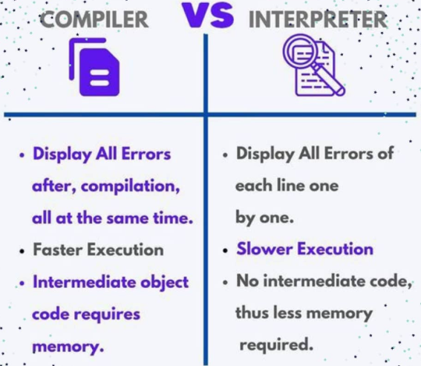
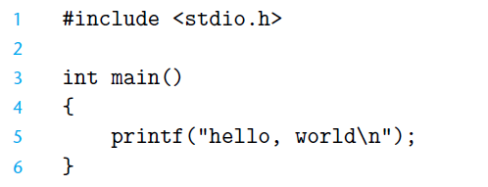
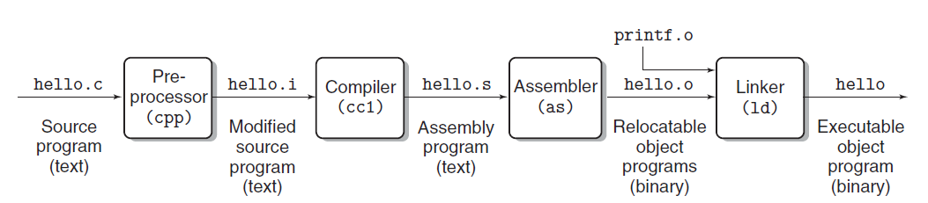
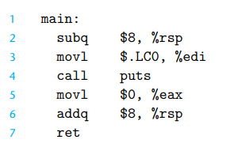
Example: Hello world
Dealing with
#include
Q: Anyone knows differences between C and Python?

Slide 11
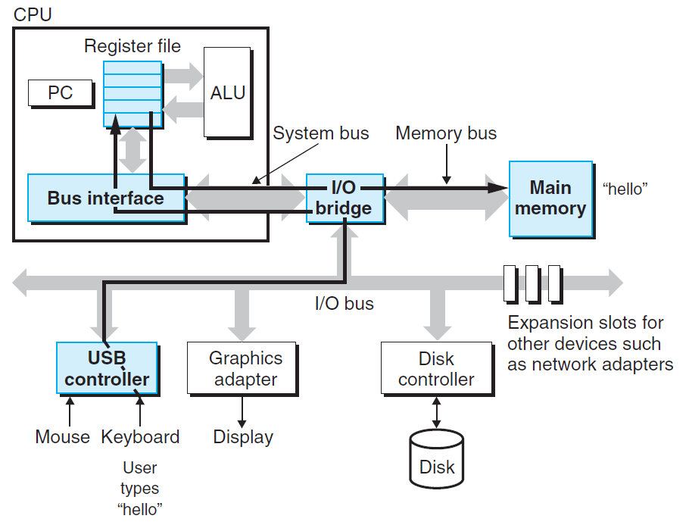
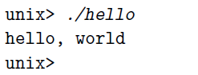
Example: Hello world
1. Shell reads the hello command into memory from the keyboard.

Slide 12
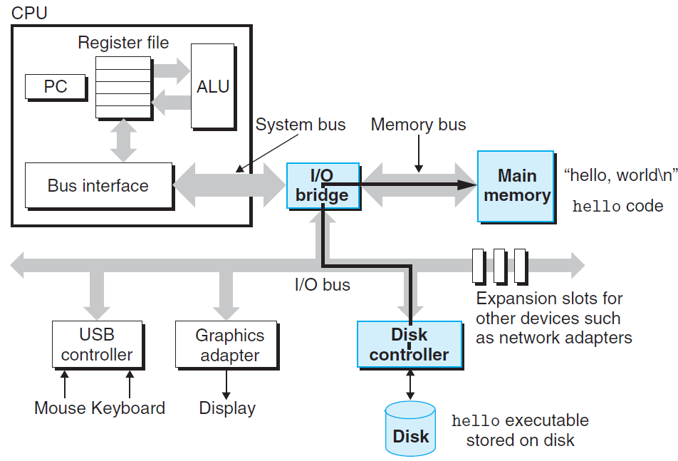
Example: Hello world
2. OS loads the executable from disk into main memory.

Slide 13
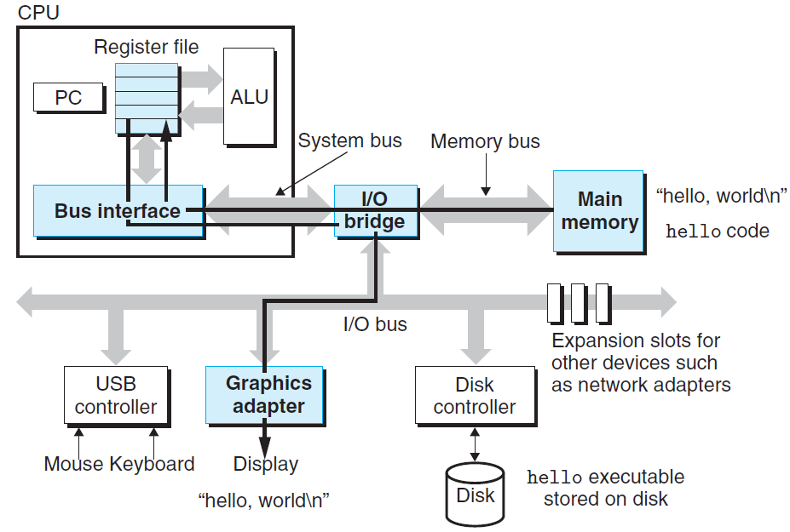
Example: Hello world
3. The OS prepares the program, which then executes itself and writes the output string from memory to the display.

Slide 14
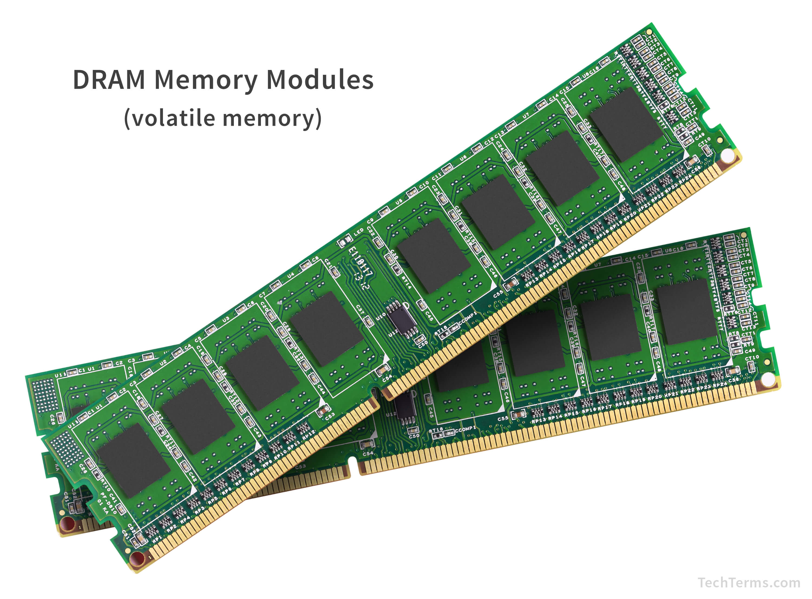
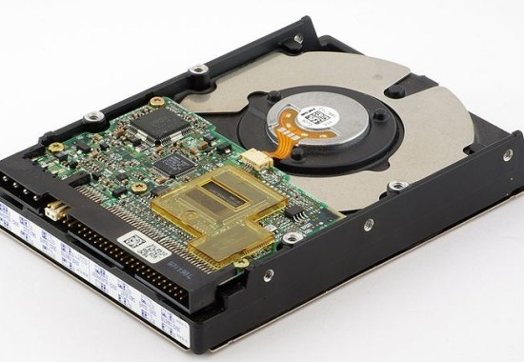
Classification of Physical Storage Media
Can differentiate storage into:
volatile storage: loses contents when power is switched off
non-volatile storage:
Contents persist even when power is switched off.
Includes secondary and tertiary storage, as well as batter-backed up main-memory.
Factors affecting choice of storage media include
Speed with which data can be accessed
Cost per unit of data
Reliability

Slide 15
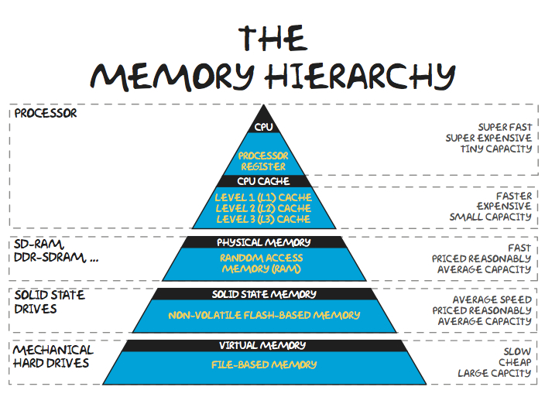
Memory Hierarchy
What is the Memory Hierarchy?
A trade-off between Speed, Cost, and Capacity.
No single storage technology is optimal for all three.
The solution: A tiered system where data is moved between layers to create the illusion of a large, fast, and cheap memory.
Key Principles:
Locality of Reference:
Temporal Locality: Recently accessed data is likely to be accessed again soon.
Spatial Locality: Data near recently accessed data is likely to be accessed soon.
Caching: Storing copies of frequently used data in faster storage.

Slide 16
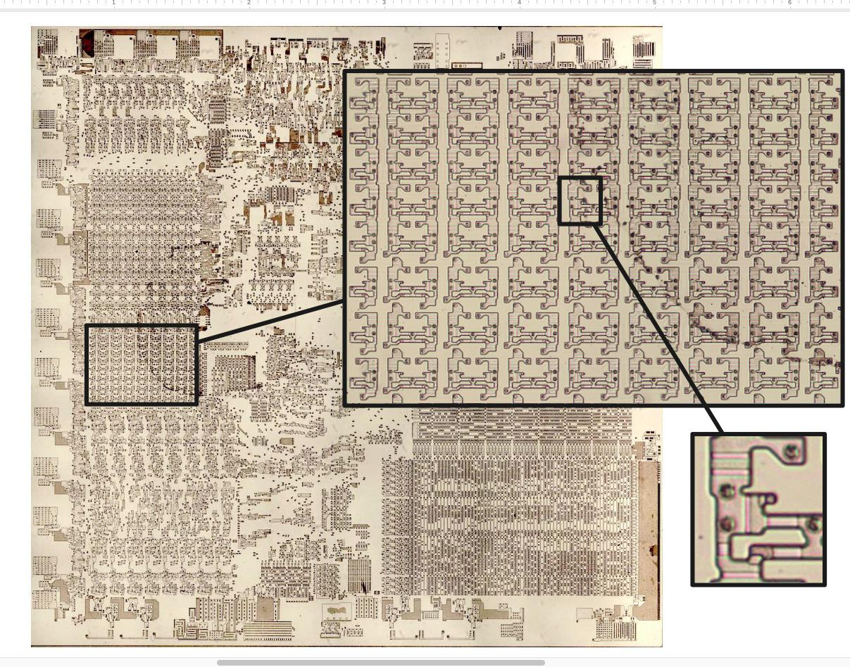
CPU Register
Location: Inside the CPU core.
Function: Hold the data the CPU is currently processing (e.g., operands for arithmetic operations, memory addresses).
Key Characteristics:
Speed: Fastest memory, operates at CPU clock speed (nanoseconds).
Size: Smallest capacity (typically a few hundred to a few thousand bytes).
Volatility: Volatile (loses data without power).
Cost: Most expensive per bit.
Managed by: The compiler and the CPU hardware.
The Intel 8086 processor's registers

Slide 17
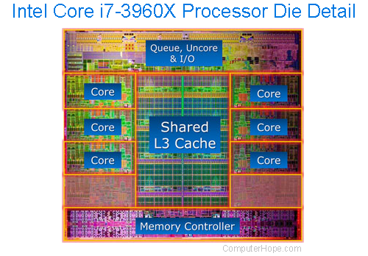
Cache
Location: On the CPU chip (L1, L2) or nearby (L3).
Function: A buffer between the CPU and main memory. It holds copies of frequently used data from main memory to reduce access latency.
Layers (L1, L2, L3):
L1: Split into Instruction and Data cache. Smallest and fastest, per CPU core.
L2: Larger than L1, slower, often per core.
L3: Shared among all cores. Largest on-chip cache, slowest of the three.
Key Characteristics:
Speed: Very fast (10s of nanoseconds).
Size: Typically 256KB - 64MB total.
Volatility: Volatile.
Managed by: Hardware automatically.

Slide 18
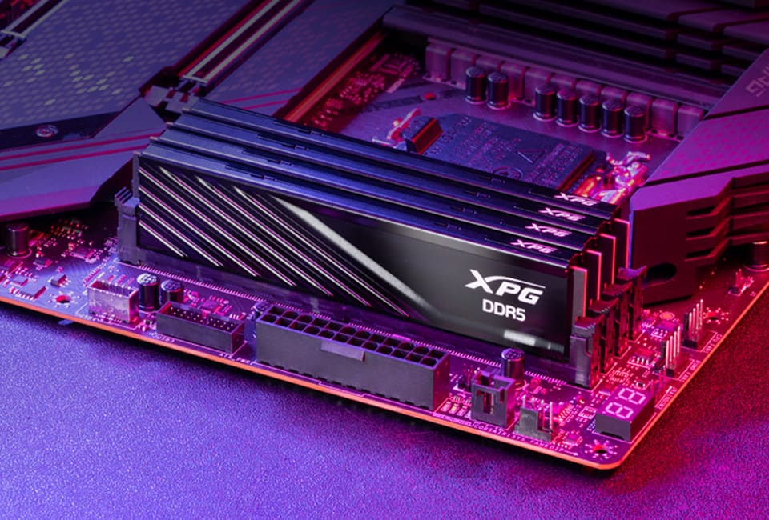
Main Memory
Location: On the motherboard, connected to the CPU via a memory bus.
Function: Holds all the data and instructions that the CPU is actively using or may use shortly. It is the "working area" for the operating system and applications.
Types:
DRAM (Dynamic RAM): The standard. Needs constant refreshing. Higher density, lower cost.
SRAM (Static RAM): Faster, no refresh needed. Used for Cache (more expensive).
Key Characteristics:
Speed: Slower than cache (~100 nanoseconds).
Size: Much larger than cache (typically 8GB - 256GB in modern systems).
Volatility: Volatile (this is why you lose unsaved work on a power cut).
Cost: Cheaper than cache, more expensive than storage.

Slide 19
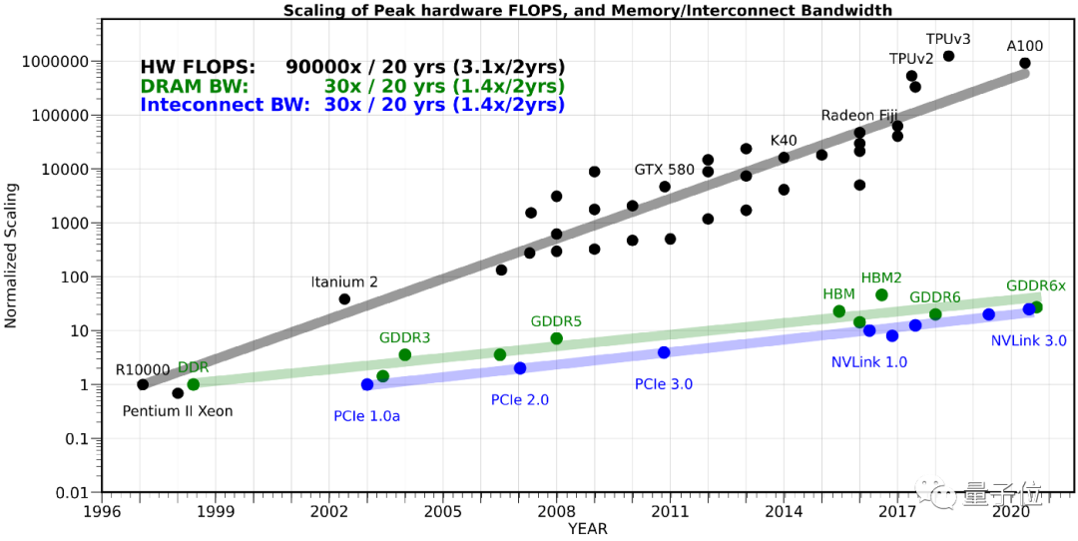
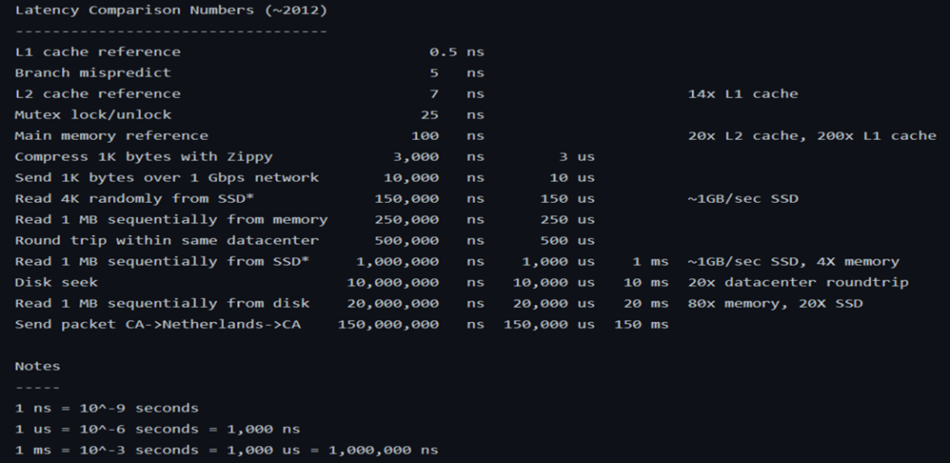
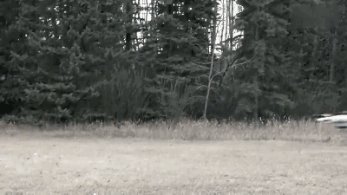

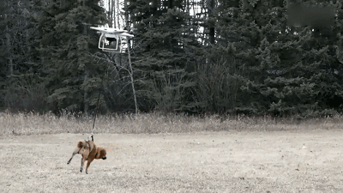
Speed Mismatch: Memory Wall
GFLOPS=Giga (10^9) Floating-point Operations Per Second
Problem: In order to read and write data, the CPU must wait for the memory
An Example of Speed Mismatching
Notes:
and the gap between them is widening
The computing speed of the cpu has been soaring

Slide 20
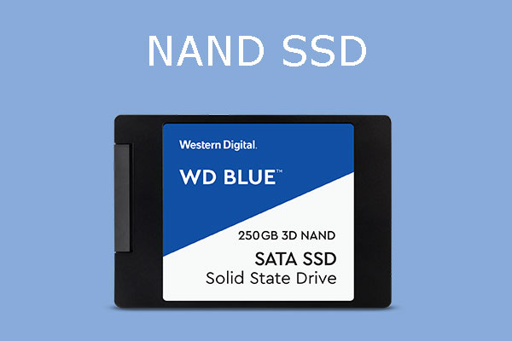
Flash Memory
Location: Inside the computer (M.2, SATA) or as an external device.
Function: The standard for persistent, high-speed storage. Replacing magnetic disks as the primary boot and storage drive.
Technology: Non-volatile. Uses NAND gates to trap electrons, representing 0s and 1s.
Key Characteristics:
Speed: Much faster than HDDs (microseconds for access), but slower than RAM.
Size: Large capacity (256GB - several Terabytes).
Volatility: Non-Volatile.
Cost: More expensive per GB than HDDs, but cheaper than RAM.
Drawbacks: Limited write cycles (wear leveling is used to mitigate this).

Slide 21
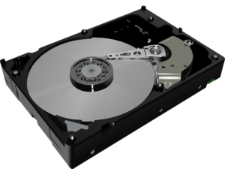
Magnetic-disk storage
Location: Inside the computer or external enclosures.
Function: Traditional mass storage for data that is not frequently accessed. Cost-effective for large capacities.
Technology: Uses rotating magnetic platters and a read/write head that moves across the surface.
Key Characteristics:
Speed: Slow (milliseconds for access due to mechanical seek time and rotational latency).
Size: Very large capacity (up to 20TB+).
Volatility: Non-Volatile.
Cost: Cheapest per GB among active storage devices.
Drawbacks: Mechanical parts are sensitive to shock and wear.

Slide 22

Optical Storage (CD, DVD, Blu-ray)
Technology: Uses lasers to read/write pits and lands on a reflective disc.
Use Case: Software distribution, media (movies, music), personal backups.
Characteristics: Very slow, portable, low capacity (700MB - 100GB), very cheap per disc.

Slide 23
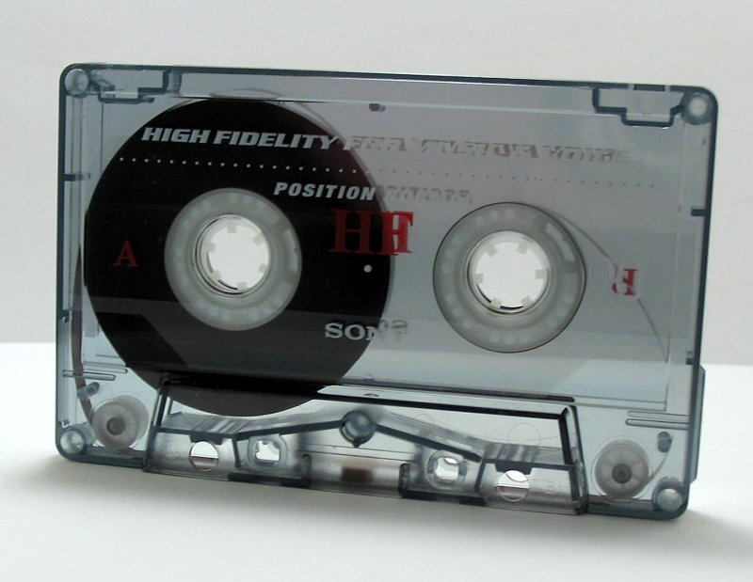
Magnetic Tape

Slide 24
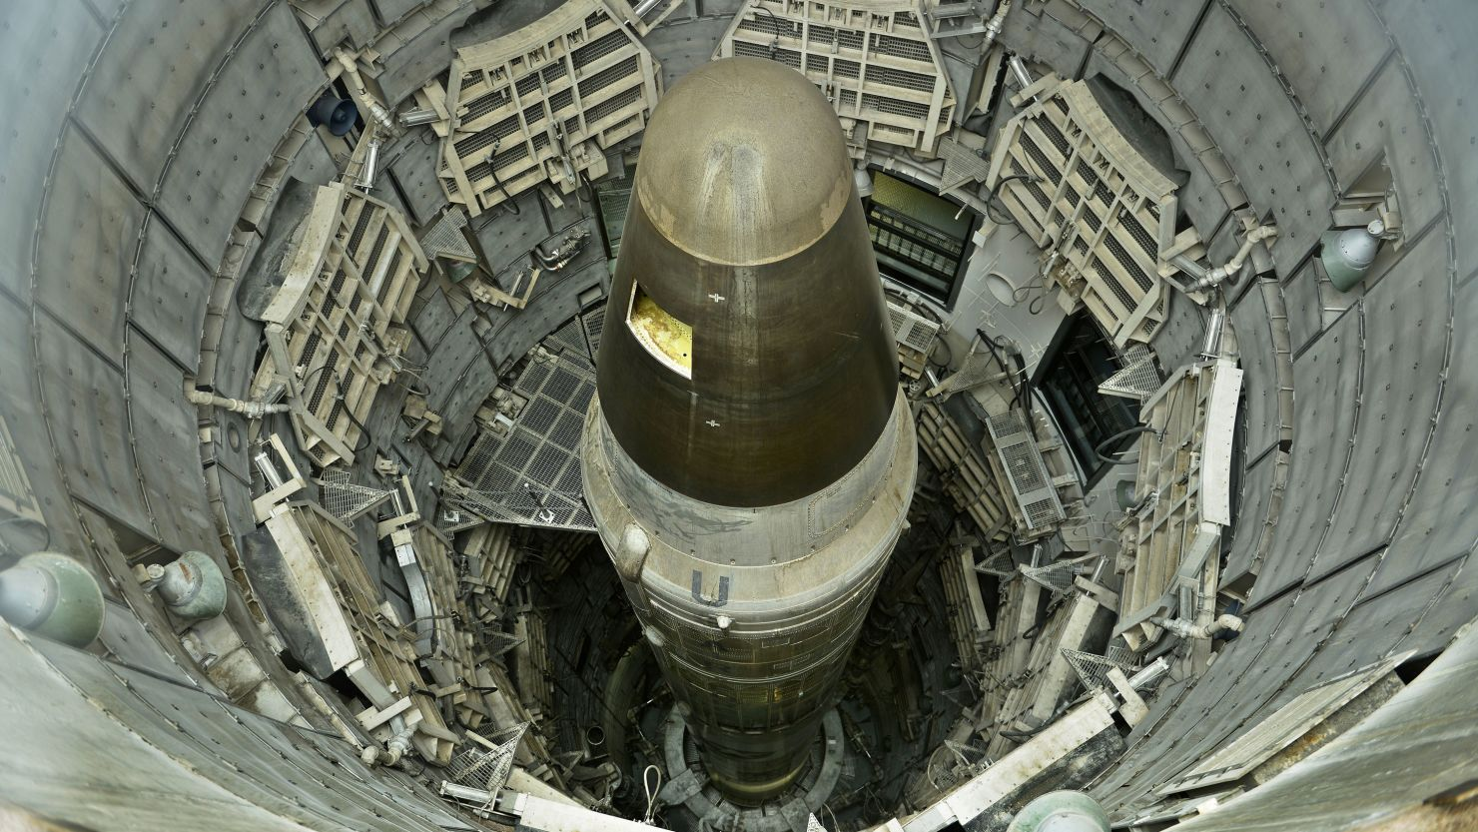
Floopy disk

Slide 25
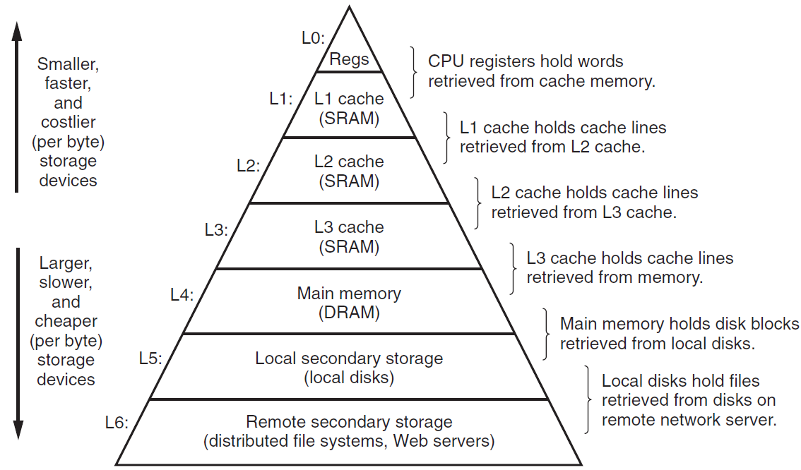
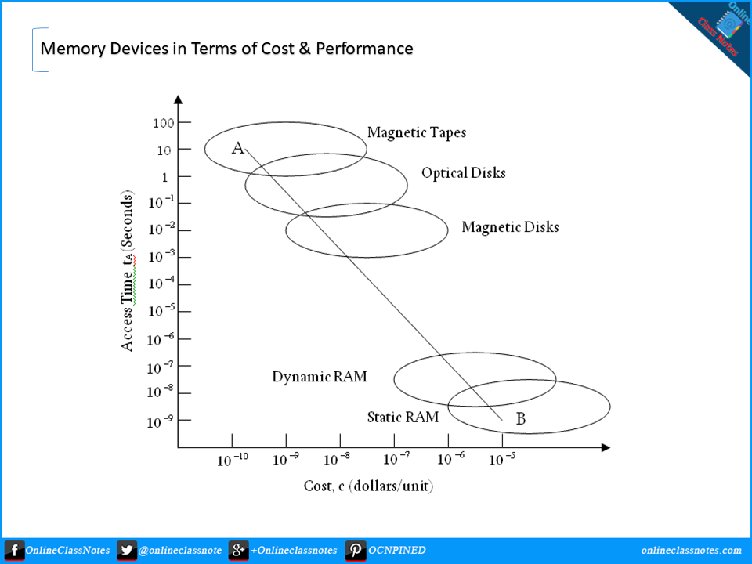
Caches matter
They can be cache at bottom!
One Time
CPU
Many Times
Register
Main Memory
Register: fast but expensive
The role of cache: play the role of agent; based on the principle of locality, it can speed up the visiting
Hierarchical cache system: Multi-Level Acceleration
Notes:
To alleviate this problem

Slide 26
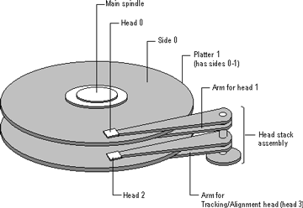
Hard Disk Drives
Key Physical Components:
Platters: Rigid, circular disks coated with a magnetic material. Data is stored here.
Spindle: The central axle that rotates the platters at high speed (e.g., 5400, 7200, 15000 RPM).
Read/Write Heads: Tiny electromagnets that read from and write to the platter surfaces. There's one head per platter side.
Actuator Arm: The mechanical arm that holds the read/write heads and moves them across the platters.
Actuator: The motor that precisely positions the actuator arm.

Slide 27
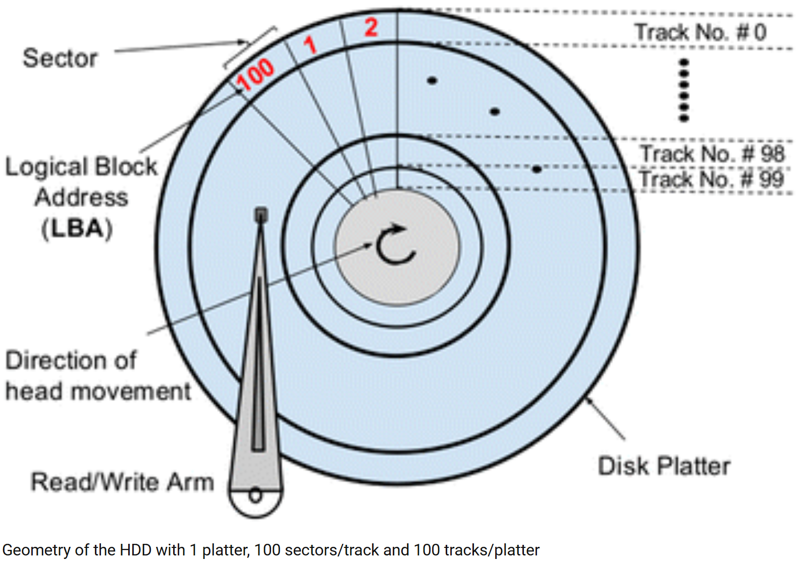
Data Organization
Data Organization:
Tracks: Concentric circles on a platter.
Sectors: Arc-shaped segments of a track (typically 512 bytes or 4KB).
Cylinder: The set of all tracks at the same actuator arm position across all platters.

Slide 28
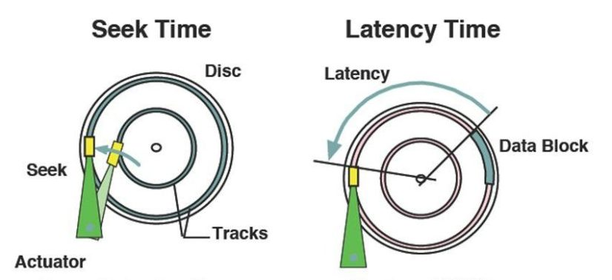
Key Performance Metrics
Performance is dominated by mechanical movement. We measure three key things:
1. Seek Time:
What it is: The time for the actuator arm to move the heads to the correct track.
Analogy: Moving the needle on a record player to the right song.
Typical Value: A few milliseconds (ms).
2. Rotational Latency:
What it is: The time for the desired sector to rotate under the read/write head after the arm is in position.
Calculation: On average, it's half the time for one full rotation. For a 7200 RPM disk: (60 sec/min) / (7200 rotations/min) / 2 ≈ 4.17ms.
3. Data Transfer Rate:
What it is: The speed at which data is read from or written to the platter once the head is positioned.
Factors: Determined by platter areal density and rotational speed.

Slide 29
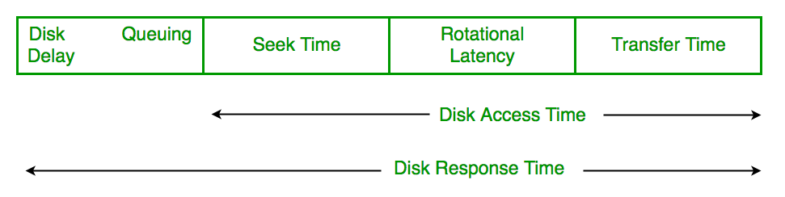
The Latency Bottleneck & Total Access Time
Total Average Access Time:
The sum of Seek Time, Rotational Latency, and a small overhead for data transfer.
Formula: Access Time ≈ Seek Time + Rotational Latency
The Mechanical Bottleneck:
This sum is why HDDs are slow compared to SSDs (which have near-zero seek/rotation times).
Access times are typically in the range of 5-15 ms.
Fragmentation makes this worse, forcing the head to seek all over the disk for a single file.
IOPS (Input/Output Operations Per Second):
A common performance benchmark derived from access time.
Rough Calculation: IOPS ≈ 1 / (Access Time in seconds). A disk with 10ms access time can theoretically handle ~100 IOPS.

Slide 30
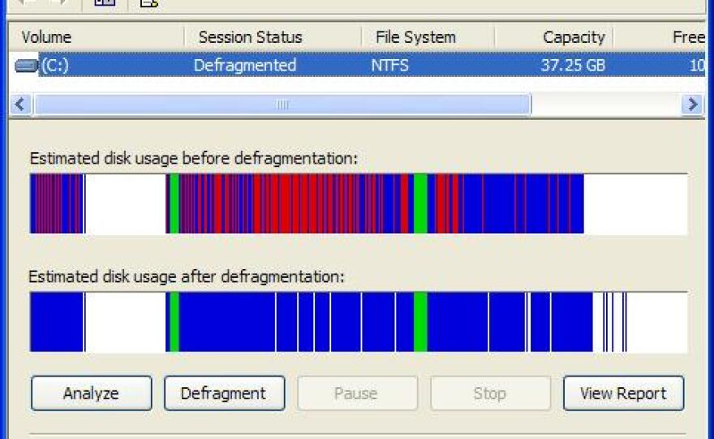
Real-World Impact & Trends
How This Affects You:
Boot Time/App Loading: Involves reading thousands of small files from random locations (high seek time).
Large File Operations: (e.g., video editing) are faster as they involve sequential reads (minimizing seek).
The Shift to SSDs:
SSDs have no moving parts, eliminating seek time and rotational latency.
This results in access times ~100x faster than HDDs.
HDD's Enduring Role:
HDDs remain dominant for cold storage and massive capacities (e.g., data centers, backup archives) due to their lower cost per Gigabyte.
Conclusion: Understanding HDD mechanics explains the fundamental performance characteristics that have shaped computing for decades.

Slide 31
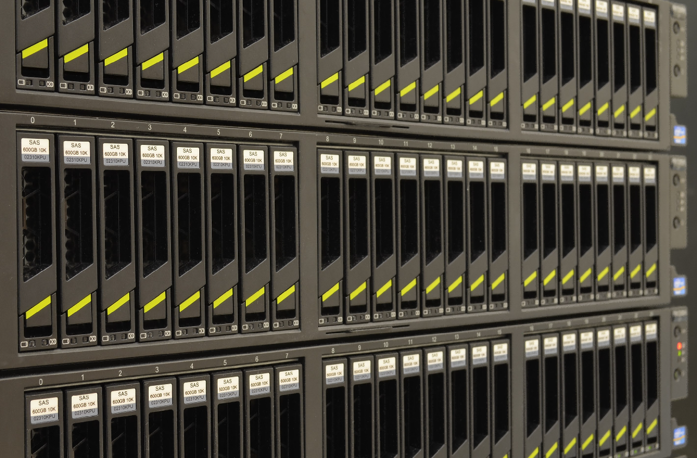
What is RAID?
RAID stands for Redundant Array of Independent Disks.
It's a technology that combines multiple physical hard drives into one logical unit.
Key Goals:
Increase Performance (Data is read/written to multiple disks at once).
Provide Redundancy (Data is protected if a drive fails).
Create Larger Storage Volumes (Combine smaller drives into one big one).

Slide 32
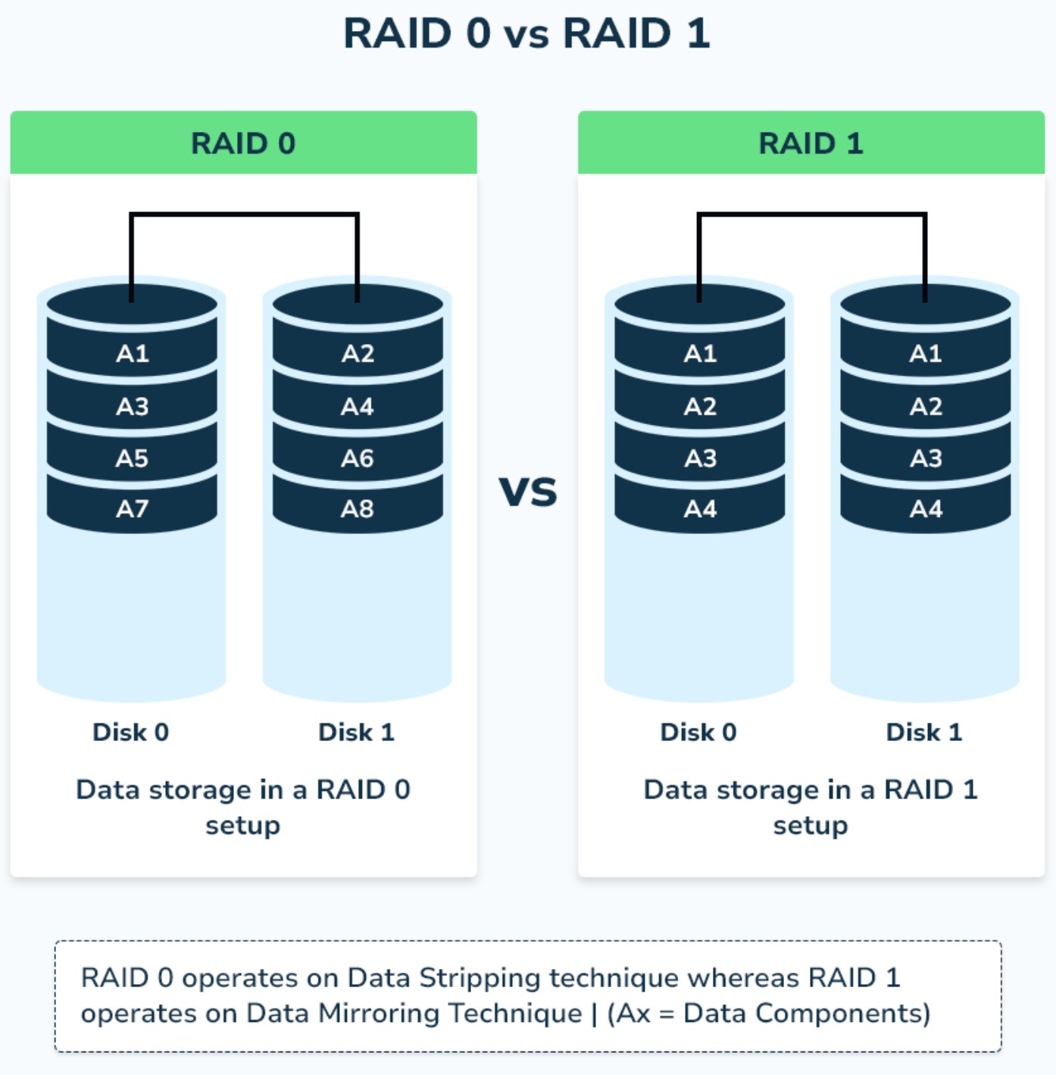
Common RAID Levels (Part 1)
RAID 0 (Striping)
How it works: Data is split into blocks and spread across all drives.
Pros: Excellent Performance (both read and write).
Cons: No Redundancy. One drive fails, all data is lost.
Use Case: Video editing, gaming—where speed is critical and data is temporary.
RAID 1 (Mirroring)
How it works: Data is written identically to two (or more) drives.
Pros: Excellent Redundancy. If one drive fails, no data is lost.
Cons: High cost (50% storage efficiency).
Use Case: Critical file servers, system drives.

Slide 33
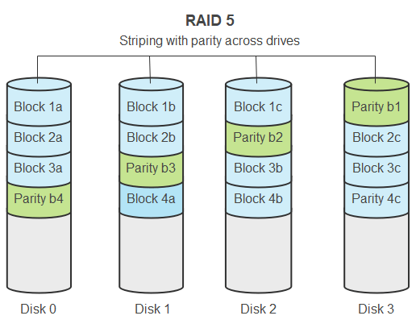
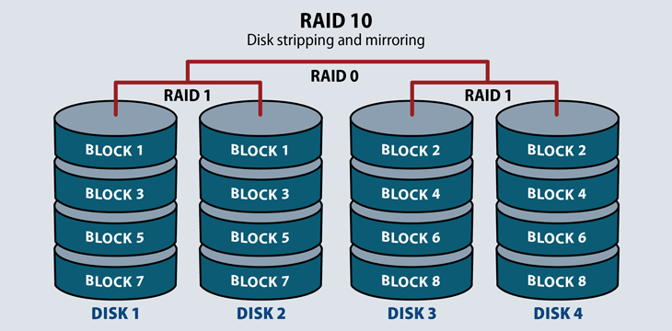
Common RAID Levels (Part 2)
RAID 5 (Striping with Distributed Parity)
How it works: Data and parity information are striped across three or more drives. Parity allows for data reconstruction if one drive fails.
Pros: Good read speed, efficient storage (loses only one drive's worth of capacity).
Cons: Slow write speeds due to parity calculation. Risky during rebuild.
Use Case: General purpose file and application servers.
RAID 10 (1+0: A Mirror of Stripes)
How it works: Combines RAID 1 and RAID 0. Disks are mirrored in pairs, and then the pairs are striped.
Pros: High performance and high redundancy. Can survive multiple drive failures (if in the right mirrors).
Cons: Highest cost (50% storage efficiency).
Use Case: High-performance databases, critical applications.

Slide 34
Lab
This week’s lab is about Rapidminer - a very powerful tool with GUI
Zero-code
Please register an eductional accout before lab!

